Slide 1
AI-Powered Timeline Reconstruction for Road Accident Forensics
TRACE
VIDEO
WITNESS
SENSOR
Team ID: HFT26-TEAM-46
Team members: [add names]
[Institution] · [Hackathon name]
Observation · Claim · Inference
Notes:
Introduce the project and team. Keep this slide non-technical. Fill in team members, institution and hackathon name.

Slide 2



Why accident evidence falls short
Partial visual evidence
Conflicting statements
Fragmented records
Accident videos show only part of the scene: limited angles, occlusion and missing moments.
Witness accounts can be incomplete, uncertain or in conflict with each other.
Sensor logs may have gaps and clocks that are not synchronized with the video.
THE CENTRAL PROBLEM
How can we combine different evidence sources to reconstruct a traceable timeline of an accident?
Notes:
Three challenges, one question. Emphasise 'traceable': every conclusion must point back to evidence.

Slide 3




Our proposed solution
STEP 1
STEP 2
STEP 3
STEP 4
Collect
Extract
Correlate
Reconstruct
Collect evidence from videos, witnesses and sensors.
Extract vehicles, events and witness claims.
Correlate evidence and identify inconsistencies.
Generate a unified timeline and spatial reconstruction.
Every finding links back to its source evidence, with a timestamp, a confidence value and an Observation / Claim / Inference tag.
Notes:
Four steps: collect, extract, correlate, reconstruct. The traceability note is our key differentiator.

Slide 4
System architecture
Dashcam video
P1
P1
P2
P3
Video processing
Event recognition
FastAPI backend
OpenCV · YOLO11 · BoT-SORT
Deep-learning module
uploads · timeline merge · storage · APIs
Evidence correlation
Witness statements
P2
Witness NLP
structured claims (JSON)
Featherless · Llama
support · contradiction · gaps · confidence
P3
Frontend and visualization
Sensor records
P2
Sensor processing
sensor events (JSON)
timeline · contradictions · trajectory map
Pandas · NumPy
P1
Computer vision
P2
Evidence intelligence
P3
Backend and frontend
All modules exchange JSON in one shared event schema, so every item keeps its source reference and confidence.
Notes:
Walk left to right: evidence in, independent processing, event recognition, correlation, backend, frontend. Do not explain algorithms here.

Slide 5
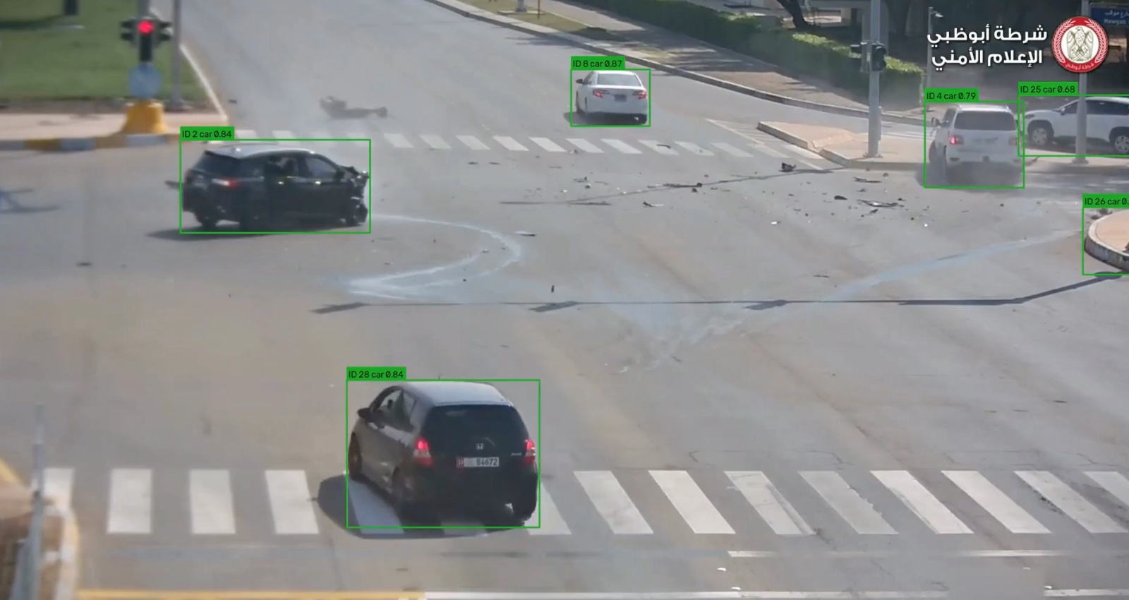
Vehicle detection and tracking
Technology | Role
OpenCV | Video preprocessing and frame extraction
YOLO11n | Vehicle detection
BoT-SORT | Vehicle tracking across frames
Insert screenshot: YOLO11 detections with BoT-SORT track IDs
Each vehicle gets a track ID
Position and bounding box in every frame
Class and detection confidence
Timestamp from the start of the clip
track 3 · car · t = 4.20 s · conf 0.87
Notes:
Show a real screenshot of detections and track IDs. Stress that IDs are local to one video and can switch during overlaps.

Slide 6
Deep-learning event recognition
INPUT
SPATIAL
TEMPORAL
DECISION
OUTPUT
Frames
CNN
Transformer
Classifier
Events
Consecutive video frames
Visual features per frame
Relationships across frames
Predicts event category
Timestamps and confidence
Initial event classes
STATUS: IN DEVELOPMENT
normal driving
sudden braking
sudden acceleration
Training and validation on traffic-event data are required before predictions are treated as reliable.
swerving
turning / lane change
stopping
near collision
collision
post-impact movement
Predictions are cross-checked against trajectory-based measurements.
Notes:
Be explicit that this module needs training and validation. Do not quote accuracy unless measured on held-out clips.

Slide 7
Witness NLP and sensor processing
Witness NLP
Sensor processing
Featherless AI with a Llama language model
Extracts vehicle descriptions, actions, directions and temporal references
Stores structured claims in JSON, keeping the original wording
Processes speed and acceleration data
Detects deceleration, impact-like spikes and stopping events
Generates timestamped sensor events from the original measurements
EXAMPLE (ILLUSTRATIVE)
EXAMPLE (ILLUSTRATIVE)
“The white car braked hard just before the crash.”
{"vehicle":"white car","action":"braked hard","time":"before impact","uncertain":true}
t = 12.4 s speed 48 → 6 km/h in 1.1 s
→ event: sudden_deceleration (sensor, derived measurement)
Notes:
Left: witness statement to structured claim. Right: sensor numbers to a timestamped event. Both keep original data separate from derived data.

Slide 8




Correlating evidence sources
Video observations
Deep-learning predictions
Witness claims
Sensor events
Comparison engine: match by time, vehicle and event type
Support
Contradict
Partial
Unverified
Evidence sources agree on relevant details.
Evidence makes incompatible claims.
Some details match, others remain unclear.
Available evidence is insufficient.
Timestamp alignment
Vehicle association
Uncertainty reporting
Notes:
Four sources in, four outcomes out. Stress the three hard parts: aligning time, matching vehicles and reporting uncertainty.

Slide 9
Unified timeline reconstruction
ILLUSTRATIVE EXAMPLE
PRE-IMPACT
IMPACT
POST-IMPACT
t = 3.8 s
t = 4.0 s
t = 4.6 s
t ≈ 5 s
Sudden braking
Deceleration spike
Possible collision
Vehicle stopped suddenly
Derived measurement
Derived measurement
Inference
Claim
Source: dashcam video, track 3
Source: simulated sensor log
Source: keyframe description
Source: witness statement
Time uncertainty: ±0.1 s
Time uncertainty: ±0.1 s
Time uncertainty: ±0.2 s
Time uncertainty: ±2 s
Confidence: 0.72
Confidence: 0.80
Confidence: 0.60
Confidence: 0.40
Each event keeps its source reference, timestamp, uncertainty and confidence.
Notes:
Example only: four events across pre-impact, impact and post-impact. Point out that the witness time is a wider uncertainty interval.

Slide 10





Spatial reconstruction
Top-down vehicle movement
Replay view · t = 4.6 s
Trajectories and direction of travel
Collision location, where established
Possible collision zone
Track 1 · car
Distance and speed, where calibrated
Synchronized original video and animation
Track 2 · car
Schematic illustration of the planned view. Replace with a screenshot or short GIF of the live reconstruction.
Notes:
Show the live demo or a GIF here. The scene drawn is a schematic only. Metric speed and distance appear only when calibration is available.

Slide 11
Results and evaluation
Module | What we demonstrate | Evidence
P1 · Vision | Vehicle detection and tracking output | [add annotated frame]
Deep learning | Event predictions and validation metrics, if available | Under evaluation
NLP | Extracted witness claims as structured JSON | [add claims output]
Sensors | Derived sensor events | [add events output]
Backend | Successful incident upload and pipeline execution | [add screenshot]
Correlation | Example evidence links and relationships | [add example link]
No accuracy figures are shown for modules that have not been evaluated; they are marked “under evaluation”.
Notes:
Replace each placeholder with a real output. Never quote accuracy numbers you have not measured.

Slide 12


Limitations and future scope
Current challenges
Future improvements
Camera calibration for moving dashcams
Reliable metric trajectory estimation
Deep-learning training and validation
Vehicle identity consistency
Synchronization of heterogeneous evidence
Better camera-motion compensation
Larger accident-event datasets
More robust vehicle re-identification
Improved spatial reconstruction
Broader real-world testing
Notes:
Keep it concise. These are honest limits, and the system reports uncertainty instead of hiding it.

Slide 13
CONCLUSION
TRACE transforms fragmented accident evidence into a synchronized, traceable and explainable reconstruction, helping investigators understand what the available evidence indicates.
Questions?
HFT26-TEAM-46 · Indicators, not legal conclusions
Notes:
Close on the one-sentence conclusion, then open for questions.

